Slide 1

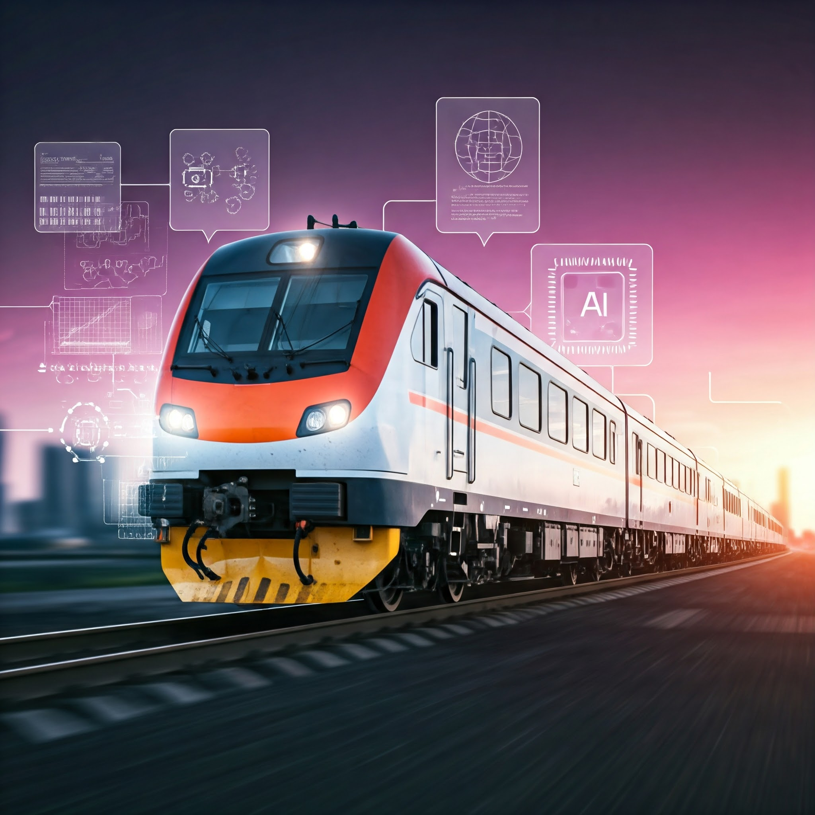
WABTEC EXCEED 3.0
AUTOMATED TRAIN SCHEDULING AND ROUTING
By: Team Decoders, MNNIT
Ravi Kumar Sharma
Lakshya Kumar
Priyansh Agrawal

Slide 2

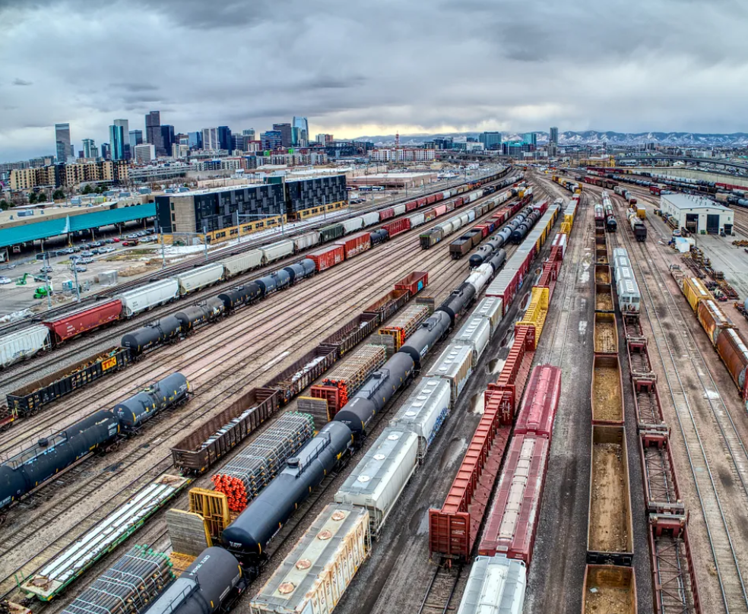
Why?
To optimize train schedules and routing using reinforcement learning (RL), considering real-world constraints, disruptions and challenges such as:
Passenger demand
Track availability
Weather disruptions
Safety regulations
Minimize delays and improve on-time performance
Maximize passenger satisfaction by reducing wait times and improving seat availability.
Enhance resource efficiency by optimizing energy/fuel usage and operational costs.

Slide 3
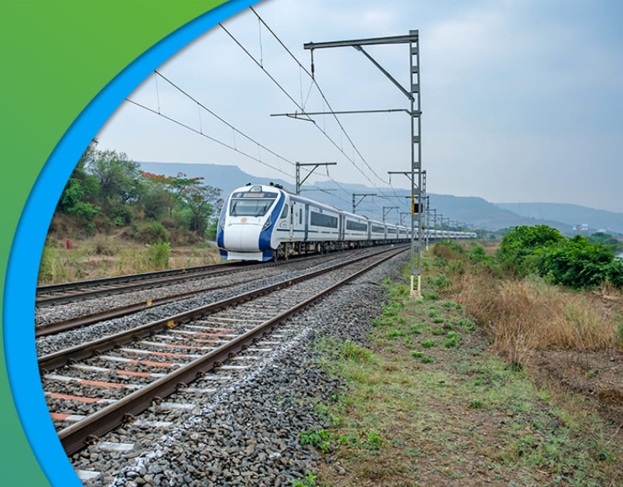
How?
Initial method incorporated rule-based systems:
Static rules: Ensured safety and operational stability (e.g., headway, capacity rules)
Dynamic rules: Adjusted for real-time disruptions (e.g., route redirection, speed changes).
Used algorithms like Dijkstra's Algorithm to ensure efficient routing.
After which Explored Reinforcement Learning (RL) Model with three approach:
Single-agent without grid: Limited metric evaluation.
Multi-agent without grid: Improved independence but lacked granularity.
Multi-agent with grid: Enhanced evaluation using a grid-based environment and Q-learning.
Achieved optimal results with grid-based multi-agent RL.

Slide 4
Implementation
First Deliverable:
Developed an RL model for train scheduling optimization:
Grid representation of the railway area.
Defined rules for penalties and rewards:
Passing through maintenance/weather areas: -2/-3.
Reaching the target: +10.
Invalid moves: -5.
Used Q-learning for adaptive decision-making.

Slide 5
Implementation Contd...
Second Deliverable:
Simulated the RL model based on historical performance metrics:
Passenger demand-driven train scheduling.
Grid environment factors like track availability, maintenance schedules, and weather conditions.
Optimized schedules to minimize delays and disruptions.

Slide 6
Implementation Contd...
Third Deliverable:
Integration into real-world rail network management systems:
Collaboration with stakeholders to define requirements.
Real-time data preprocessing and simulation environment setup.
API-based integration for live updates and decision-making.
Operator training and system monitoring.

Slide 7
Scalability and Optimization:
Scalability and Optimization strategies:
Enhanced Grid Size and Resolution.
Multi-Agent Collaboration.
Dynamic Real-Time Updates (GPS).
Distributed Computing for Large Networks.
Using Internet of Things (IoT) devices to gather data directly from trains, tracks, and stations.
Periodic Model Updates and Adaptability.

Slide 8
The End.
Thank You

